Slide 1


香港中成藥註冊制度
與
進出口規管
香港中成藥藥品及保健品行業如何拓展東盟市場研討會 暨 東盟國家藥品進口註冊要求研討會 之
Registration System,
import and Export Control of Proprietary Chinese Medicine
in Hong Kong
衞生署
中醫藥事務部
2019年1月

Slide 2

內容
Contents
香港對藥品規管的相關法規
Legal Basis for Drug Control
香港中成藥的註冊制度
Registration System of
Proprietary Chinese Medicine
(PCM)
香港中成藥的進出口制度
Import & Export Control of
PCM

Slide 3
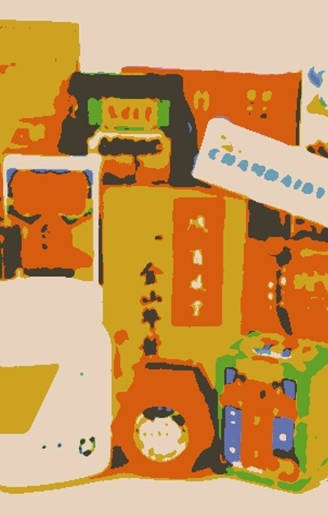
香港對
藥品規管
的相關法規
Legal Basis for
Drug Control

Slide 4

香港對藥品規管相關法規
Legal Basis for Drug Control
基本法第138條
Article 138 of Basic Law
香港特別行政區政府自行制定發展中西醫藥和促進醫療衞生服務的政策
The HKSAR Government shall, on its own, formulate policies to develop western and Chinese medicine and to improve medical and health services

Slide 5
香港對藥品規管相關法規
Legal Basis for Drug Control
中西藥規管法例
香港法例第138章(Cap.138)
《藥劑及毒藥條例》
Pharmacy and Poisons Ordinance
條例旨在綜合和修訂與藥劑業及毒藥有關的法律
To consolidate and amend the law relating to pharmacy and poisons
香港法例第137章(Cap.137)
《抗生素條例》
Antibiotics Ordinance
條例旨在管制某些抗生素物質的銷售與供應
To control the sale and supply of certain antibiotic substances
香港法例第134章(Cap.134)
《危險藥物條例》
Dangerous Drugs Ordinance
條例旨在修訂和綜合與危險藥物有關的法例
香港法例第549章(Cap.549)
《中醫藥條例》
Chinese Medicine Ordinance
條例旨在就中醫的註冊、中藥業者的領牌、中成藥的註冊以及其他有關事宜訂立條文
An Ordinance to make provisions for the registration of practitioners in Chinese medicine; the licensing of traders in Chinese medicines; the registration of proprietary Chinese medicines; and other related matters
To amend and consolidate the law relating to dangerous drugs

Slide 6


香港對藥品規管相關法規
Legal Basis for Drug Control
其他法例要求 (1)
香港法例第362章(Cap.362)
《商品說明條例》
Trade Descriptions Ordinance
為禁止在營商過程中就有關商品作出虛假說明、虛假標記和錯誤陳述而訂定的條文
香港法例第559章(Cap.559)
《商標條例》
Trade Marks Ordinance
就規範註冊商標的使用而訂定的條文
relevant sections on regulating the use of registered trade marks
relevant sections on prohibition of false description, false signs and/or fraudulent statements of products

Slide 7

香港對藥品規管相關法規
Legal Basis for Drug Control
其他法例要求 (2)
就規管藥物是否適宜供人使用及對藥物購買人的一般保障而訂定的條文
香港法例第132章(Cap.132)
《公共衞生及市政條例》
Public Health and Municipal Services Ordinance
香港法例第231章(Cap. 231)
《不良廣告 (醫藥)條例》
Undesirable Medical Advertisements Ordinance
就限制藥物的名稱、宣稱及標籤而訂定的條文
relevant sections on regulating the names, claims and labels of medicinal products
relevant sections on regulating whether a drug is suitable for human consumption and general protection for purchasers of drugs
香港法例第60章(Cap.60)
《進出口條例》
Import and Export Ordinance
就規管及控制包括中成藥及中藥材輸入和輸出香港而訂定的條文
relevant sections on regulating and controlling the import and export of pCms and Chinese herbal medicines into and out of Hong Kong
香港法例第586章(Cap.586)
《保護瀕危動植物種條例》
Protection of Endangered Species of Animals & Plants Ordinance
就限制瀕危動植物的進口、出口及管有而訂定的條文
relevant sections on restrictions on the import, export and possession of endangered species of plants & animals

Slide 8
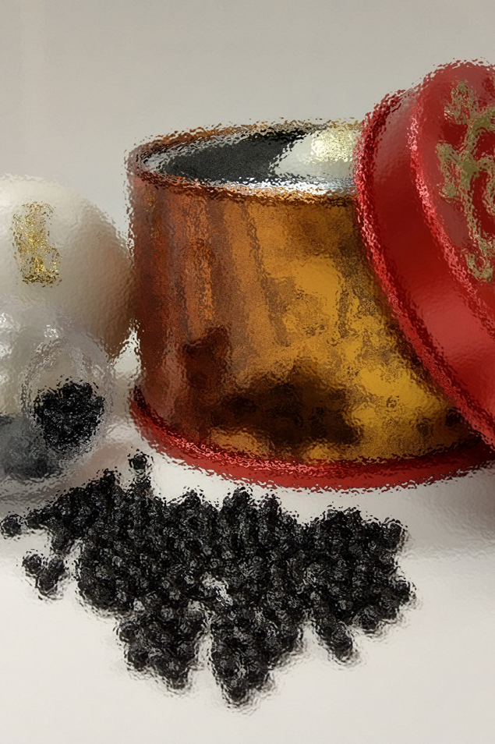
香港中成藥的註冊制度
Registration System of PCM

Slide 9
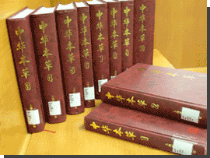

中成藥的釋義
Definition of PCM
根據《中醫藥條例》第2條，“中成藥”是指任何符合下述說明的專賣產品─
According to Section 2 of the Chinese Medicine Ordinance (CMO),
"proprietary Chinese medicine" means any proprietary product -
(a) 純粹由下述專案作為有效成分組成─
composed solely of the following as active ingredients-
(i) 任何中藥材；或
any Chinese herbal medicines,
(ii) 慣常獲華人使用的任何源於植物、動物或礦物的物料；或
any materials of herbal, animal or mineral origin customarily used by the Chinese; or
(iii) 第(i)及(ii)節分別提述的任何藥材及物料；
any medicines and materials referred to in subparagraphs (i) and (ii) respectively;
(b) 配製成劑型形式；及
formulated in a finished dose form; and
(c) 已知或聲稱用於診斷、治療、預防或紓緩人的疾病或症狀，或用於調節人體機能狀態。
known or claimed to be used for the diagnosis, treatment, prevention or alleviation of any disease or any symptom of a disease in human beings, or for the regulation of the functional states of the human body.

Slide 10
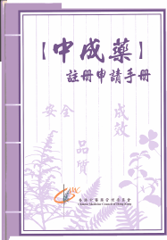
中成藥註冊的規定
PCMs to be Registered
所有中成藥均須註冊，方可進口、在本港製造和銷售
All kinds of pCm must first be registered by the Chinese Medicines Board (CMB) under the Council before they can be imported, manufactured and distributed in Hong Kong
符合安全、品質、成效三方面的要求
Ensure
safety, quality
and efficacy of products
自2003年12月19日中成藥註冊制度開始，中藥組共收到超過18,000 份中成藥註冊申請
Since the implementation of pCm registration system on 19 Dec 2003, the CMB has received over 18,000 applications for pCm registration

Slide 11
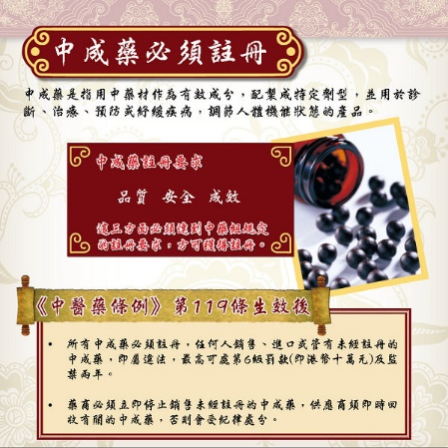
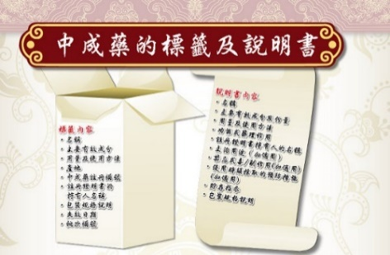
中成藥註冊的規定
PCMs to be Registered
《中醫藥條例》第119條已於2010年12月3日開始生效，任何人不得銷售、進口或管有任何未經註冊的中成藥，否則即屬違法**
Section 119 of the CMO has become effective on 3 December 2010. No person shall sell, import or possess any pCm unless the pCm is registered
《中醫藥條例》第143及144條已於2011年12月1日生效，任何人不得銷售或為銷售而管有，沒有附上符合訂明規定的標籤或說明書的中成藥，否則即屬違法**
Sections 143 and 144 of the CMO has become effective on 1 December 2011. No person sell or have in his possession for the purpose of selling any pcm without label and package insert
    **違例者可被判罰款港幣十萬元和監禁兩年。
  Contravention may lead to fine HK$100,000 and 2 years imprisonment.

Slide 12
註冊資料的要求
Documents Required for Registration of PCMs
一般資料 General documents
完整處方
  Master formula
製造或銷售歷史證明文件
  Proof of manufacturing or sales history
標籤、說明書
  Label & package insert
樣本及銷售包裝的樣板
Product sample & prototypes of sales pack
安全性資料 Product Safety documents
  重金屬及有毒元素含量測試報告
  Heavy metals & toxic elements test report
  農藥殘留量測試報告
  Pesticide residues test report
  微生物限度測試報告
  Microbial limit test report
  急性/長期/局部毒性試驗報告
  Acute / long term /local toxicity test report
  致突變試驗報告、致癌試驗報告、生殖毒性試驗報告
  Test reports on mutagenicity , carcinogenicity &
  reproductive toxicity
成效性資料 Product Efficacy documents
  組方原則及方解
  Interpretation & principle of formulating a prescription
  成效性參考資料
  Reference materials on product efficacy
  藥效學藥理學臨床研究報告
  Reports on product efficacy evaluation & clinical trials
品質性資料 Product Quality documents
製造方法
Manufacturing method
原料理化性質資料
Physicochemical properties of crude drug
品質標準、化驗方法及化驗報告
Product specification, certificate of analysis
穩定性試驗報告
Stability reports

Slide 13
技術指引
Technical Guidelines
【中成藥註冊】
安全性資料
技術指引
Product Safety
Documents
【中成藥註冊】
品質性資料
技術指引
Product Quality
Documents
【中成藥註冊】
成效性資料
技術指引
Product Efficacy
Documents
各項安全性、品質性、成效性試驗的技術要求，可參閱有關的技術指引
Refer to the Technical Guidelines for Registration of pCms for the requirements on products Safety, Quality and Efficiency

Slide 14

本地製造只供出口中成藥註冊申請
Registration of Locally Manufactured PCMs for
Export Only
要提出「只供出口」中成藥的註冊申請，有關的產品必須源自一款
已獲發「中成藥註冊證明書」（HKC）或
「確認中成藥過渡性註冊通知書」（HKP）的供本地銷售中成藥
In making an application for registration of a pCm "for export only", the product must originate from a pCm for local sale that has been issued with a "Certificate of registration of pCm" (HKC) or a "Notice of confirmation of transitional registration of pCm" (HKP)
「只供出口」中成藥當出口至不同國家或地區時
可能要符合當地不同形式的管制要求
而有以下不同的情況
Having regard to the fact that pCms "for export only" may be subject to various forms of local regulatory control when exported to different countries or regions, they may have the following variation:
❶ 「只供出口」中成藥
與其源自的供本地銷售
中成藥處方相同
The pCm "for export only" has the same formula as the pCm for local sale from which the former originates
❷ 「只供出口」中成藥
與其源自的供本地銷售
中成藥處方不同
The pCm "for export only" has a different formula from the pCm for local sale from which the former originates

Slide 15
本地製造只供出口中成藥註冊申請
Registration of Locally Manufactured PCMs for
Export Only
❶ 在「只供出口」中成藥與其源自的供本地銷售中成藥處方相同的情況下，本地製造商若要為其「只供出口」中成藥申請註冊須要提交下述的基本註冊文件
When the pCm "for export only" has the same formula as the pCm for local sale from which the former originates, a local manufacturer must submit the following basic documents in order to apply for registration of a pCm "for export only"
由製造商發出印有該「只供出口」中成藥名稱的完整處方
A master formula printed with the name of the pCm "for export only" issued by the manufacturer
出口國家或地區的監管部門發給該「只供出口」中成藥的合法銷售證明文件（例如自由銷售證明書）
Documentary proof of legal sale issued in respect of the pCm "for export only" by regulatory authorities of the countries or districts to which it is exported (e.g. Free Sale Certificate)
符合《中藥規例》第27條的標籤樣稿、銷售包裝樣板
The prototype label and sales pack in compliance with section 27 of the Chinese Medicines Regulation
該「只供出口」中成藥的重金屬及有毒元素含量的測試報告、農藥殘留量的測試報告及微生物限度的測試報告
The heavy metals and toxic elements test report, pesticide residues test report and microbial limit test report of the pCm "for export only”
就個別個案，中藥組認為需要的其他文件或資料
Any other documents or information deemed necessary by the CMB on individual cases

Slide 16
本地製造只供出口中成藥註冊申請
Registration of Locally Manufactured PCms for
Export Only
在「只供出口」中成藥與其源自的供本地銷售中成藥處方不同的情況下，本地製造商若要為其「只供出口」中成藥申請註冊須要提交下述的基本註冊文件
When the pCm "for export only" has a different formula from the pCm for local sale from which the former originates, a local manufacturer must submit the following basic documents in order to apply for registration of a pCm "for export only"
按產品處方組成，選擇適合的註冊類別作註冊申請
Choose an appropriate classification category for the product according to its ingredients and apply for registration
如果有關製造商能提供以下的證明，則該「只供出口」中成藥仍可歸類為「固有藥類別」：
If the manufacturer can provide the following evidence, then the pCm "for export only" can still be classified as an "Established medicine“:
有關更改是因應銷售國家或地區的要求或規定
The amendment is made in accordance with the requirement or regulation of the country/district for the sale
有關更改是在已獲過渡性註冊或已獲正式註冊的中成藥的處方上作加減；以及
The amendment is made to the prescription of a pCm that is transitionally registered or registered; and
有關更改對產品在藥效及藥理沒有太大的改變，例如君藥及臣藥不應有更改
The amendment does not cause any major change to the pharmacodynamic and pharmacological effects of the product. For example, the principal and assistant drug(s) shall not be changed
由製造商發出印有該「只供出口」中成藥名稱的完整處方
A master formula printed with the name of the pCm "for export only" issued by the manufacturer
出口國家或地區的監管部門發給該「只供出口」中成藥的合法銷售證明文件（例如自由銷售證明書）
Documentary proof of legal sale issued in respect of the pCm "for export only" by regulatory authorities of the countries or districts to which it is exported (e.g. Free Sale Certificate)
符合《中藥規例》第27條的標籤樣稿、銷售包裝樣板
The prototype label and sales pack in compliance with section 27 of the Chinese Medicines Regulation
該「只供出口」中成藥的重金屬及有毒元素含量的測試報告、農藥殘留量的測試報告及微生物限度的測試報告
The heavy metals and toxic elements test report, pesticide residues test report and microbial limit test report of the pCm "for export only”
按其註冊類別，全面提交相應的安全、品質及成效性資料
Comprehensive information on the safety, quality and efficacy of the product with reference to its classification category

Slide 17
出口的中成藥的標籤
Labelling of PCMs to be Exported
任何人如出口或為出口而管有在香港製造的中成藥，
則須確保相當可能會銷售或分銷予該成藥的最終用家的該成藥的
最外層包裝上的標籤 ——
A person who exports or has in his possession for the purpose of exporting a pCm manufactured in Hong Kong shall ensure that a label on the outermost package of the medicine likely to be sold or distributed to an ultimate user of the medicine—
包括以下詳情——
includes the following particulars—
該成藥的名稱
載列的詳情是清楚及明確地列明，並且沒有在任何方面模糊或經塗改
has the particulars being clearly and distinctly set out and not in any way obscured or obliterated
該成藥的註冊證明書上指明的中成藥註冊編號
該成藥的註冊證明書上指明的證明書持有人的姓名或名稱
the name of the holder of the certificate of registration of the medicine as specified in the certificate
the registration number of the medicine as specified in its certificate of registration
the name of the medicine

Slide 18
中成藥自由銷售證明
Certificate of Sale of PCMs
中成藥自由銷售證明
Certificate of Sale of PCMs
中成藥銷售證明書
Certificate of Sale of PCMs
中成藥自由銷售證明信件
Proof of Free Sale of PCMs
持有：
「中成藥註冊證明書」（HKC）；或
「確認中成藥過渡性註冊通知書」（HKP）
的持牌中成藥製造商
Licensed manufacturers of pCm holding:
Certificate of Registration of PCM (HKC) or
Notice of Confirmation of Transitional Registration of PCM (HKP)
不符合申請「中成藥銷售證明書」的資格，例如：
為持牌中成藥批發商；或
屬已獲發「確認中成藥註冊（非過渡性）申請通知書」（HKNT）的產品申請人；或
產品為「只供出口」中成藥
If the applicant is not qualified for applying for “Certificate of Sale of Proprietary Chinese Medicines” , for instance:
the applicant is a licensed wholesaler of proprietary Chinese medicines; or
the proprietary Chinese medicine has been issued with a "Notice of Confirmation of (Non-Transitional) Registration Application of Proprietary Chinese Medicines" (HKNT); or
the proprietary Chinese medicine is "for export only"

Slide 19
中成藥自由銷售證明
Certificate of Sale of PCMs
中成藥銷售證明書
Certificate of Sale of PCMs
申請人須提交的資料
Documents shall be submitted by the applicant
HKP產品：產品標籤及說明書樣本
HKP products: Prototypes of labels of and package inserts
HKC／HKP的副本
Copy of HKC/HKP
「中成藥銷售證明書」的申請書
The application form for "Certificate of Sale of PCMs"
如申請獲中藥組批准
If the application is approved by the CMB
有關證明書將於申請人在繳交有關費用後發出
The relevant certificate will be issued upon the payment of the prescribed fee
有效期為2年
The certificate is valid for 2 years

Slide 20
中成藥自由銷售證明
Certificate of Sale of Proprietary
Chinese Medicines
中成藥自由銷售證明信件
Proof of Free Sale of PCMs
申請人須提交的資料
Documents shall be submitted by the applicant
產品標籤及說明書樣本(如有需要)
Prototypes of labels of and package inserts (if necessary)
書面提出申請
The application shall be made in writing
如申請獲中藥組批准
If the application is approved by the CMB
有關證明信件的有效期為1年
The proof of free sale is valid for 1 year

Slide 21
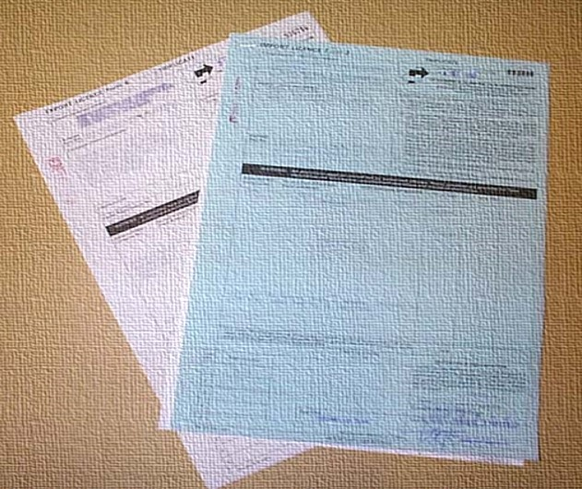
香港中成藥的進出口制度
Import & Export Control of PCMs

Slide 22

香港中成藥的進出口制度
Import & Export Control of PCMs
並非《中醫藥條例》內的要求
Requirements not stated in the CMO
根據《進出口條例》(第60章)第6C(1)條及第6D(1)條，任何人士必須已獲工業貿易署署長簽發的進出口證，並遵行證上所述規定，方可輸入或輸出藥劑製品及藥物
Under sections 6C(1) and 6D(1) of the Import and Export Ordinance (Cap. 60), any person who wish to import or export certain prohibited articles must first obtain import or export licence issued by the Director-General of Trade and Industry

Slide 23
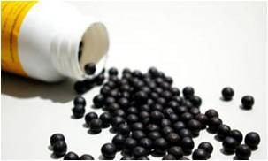
申請要求
Requirements of Application
中成藥進口許可證
Import Licence of PCM
填妥的申請表格(進口許可證表格三) (一式四份)
Completed application form (form 3)(in quadruplicate)
中成藥批發商牌照或製造商牌照副本；或有關機構是獲中藥組根據《中醫藥條例》第158(1)條豁免領取牌照以進口該中成藥的證明文件副本
Copy of valid trader licence, or licence exemption document as approved by the CMB for research /
education institution
以下文件的副本及相關的授權證明文件(如有)：
Copy of the following documents / authorization (if any)：
  「中成藥註冊證明書」/「確認中成藥過渡性註冊通知書」/ 「確認中成藥註冊(非過渡性)申請通知書」Registration certificate / documents of pCm (for registered pCm)
  「臨床證驗及藥物測試證明書」 Clinical trial / medicinal test of a pCm
  中醫藥管理委員會轄下中藥組根據《中醫藥條例》第158(1)條發出的文件，證明有關中成藥是為教育或科學研究而獲豁免
Registration exemption document of a pCm as approved by CMB for research / education institution

Slide 24
申請要求
Requirements of Application
中成藥進口許可證(續)
Import Licence of PCM (Con’t)
進口供中成藥註冊用途(一般的進口數量不得超過六個銷售單位)：
For unregistered pCm imported for registration purpose (in general < 6 sales units)：
  須於申請表格上寫明「供註冊用」
  Mark “for registration purpose” on application form
進口中成藥供轉口用途及未能提供第(3)點的證明文件：
For unregistered pCm imported for re-export purpose：
  須於表格上寫明「只作轉口用」
  Mark “for re-export only” on application form
  提供該中成藥（由製造商所簽發）的詳盡百分比成分表的副本
  Provide formula of pCm listed with 100% ingredients issued by the manufacturer
中醫藥事務部網站 (www.cmd.gov.hk) -「中成藥進出口許可證申請指南」
Website of the Chinese Medicine Division – “Guidelines for Application for Import/Export Licence of PCM”
www.cmd.gov.hk/html/b5/aboutus/service/ieccm/ie_pcm_chi.pdf

Slide 25
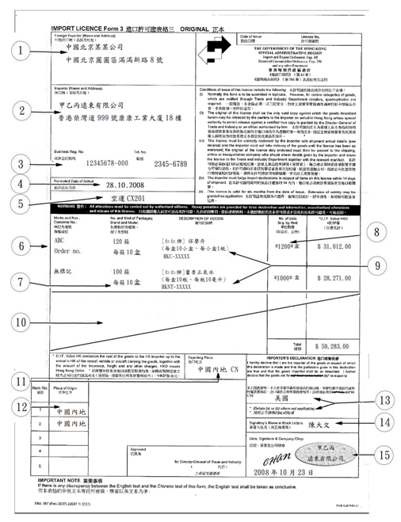
申請要求
Requirements of Application
1. 外地出口商(名稱及地址)
Foreign Exporter (Name and Address)
2. 進口商(名稱及地址)
Importer (Name and Address)
3. 商業登記號碼
Business Reg. No.
4. 預計抵達日期
Estimated Date of Arrival
5. 船隻/班機/車輛編號
Vessel/Flight/Vehicle Number
6. 標記及編號；貨櫃編號
Marks and Nos.; Container No.
7. 包裹數目及種類
No. and Kind of Packages
8. 單位數量
No. of Units
9. 貨物的說明
Description of Goods
10. 空白地方必須刪去
Blank space must be crossed out
11. 出口地方
Exporting Place
12. 來源地方
Place of Origin
13. 進口商聲明書
Importer’s Declaration
14. 簽署人姓名
Signatory’s Name in Block Letters
15. 日期、簽署及公司印章
Date, Signature and Company Chop
申請表格(進口許可證表格三)
Import Licence Application Form (Form 3)

Slide 26
申請要求
Requirements of Application
中成藥出口許可證
填妥的申請表格(出口許可證表格六) (一式三份)
Completed application form (in triplicate)
中成藥批發商牌照/製造商牌照副本
Copy of valid trader licence
以下文件副本(如有)：
Copy of the following documents (if any)：
  中成藥註冊證明書/確認中成藥過渡性註冊通知書/「確認中成藥註冊(非過渡性)申請通知書」
  Copy of the Registration certificate / documents of pCm (for registered pCm)
如出口的中成藥是作轉口用途及未能提供第3點的證明檔，則可提供該中成藥進口許可證的副本
If the pCm to be exported is under re-export purpose, submit a copy of the
concerned approved imported licence
中醫藥事務部網站 (www.cmd.gov.hk) -「中成藥進出口許可證申請指南」
Website of the Chinese Medicine Division – “Guidelines for Application for Import/Export Licence of PCM”
www.cmd.gov.hk/html/b5/aboutus/service/ieccm/ie_pcm_chi.pdf

Slide 27
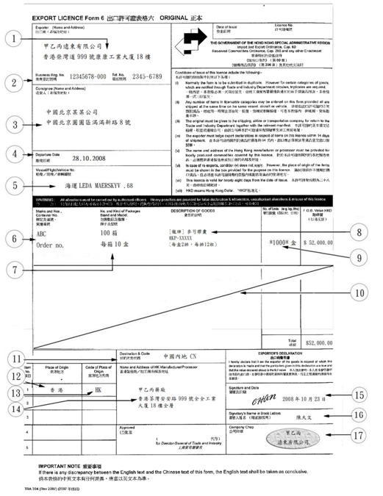
申請要求
Requirements of Application
1. 出口商(名稱及地址)
Exporter (Name and Address)
2. 商業登記號碼
Business Reg. No
3. 收貨人(名稱及地址)
Consignee (Name and Address)
4. 離境日期
Departure Date
5. 船隻/班機/車輛編號
Vessel/Flight/Vehicle No.
6. 標記及編號，貨櫃編號
Marks and Nos.; Container No.
7. 包裹數目及種類
No. and Kind of Packages
8. 貨品的說明
Description of Goods
9. 單位數量
No. of Units
10. 空白地方必須刪去
Blank space must be crossed out
11. 目的地及代碼
Destination and Code
12. 來源地方
Place of Origin
13. 來源地方代碼
Code of Place of Origin
14. 香港製造商/加工商名稱及地址
Name and Address of HK Manufacturer/Processor
15. 簽署及日期
Signature and Date
16. 簽署人姓名
Signatory’s Name in Block Letters
17. 公司印章
Company Chop
申請表格(出口許可證表格六)
Export Licence Application Form (Form 6)

Slide 28
收件程序
出證/退件程序
進/出口許可證
申請人(中藥商)
進/出口許可證申請人(中藥商)
退回文件
收據
收據
進/出口許可證申請人
(中藥商)
申請文件
進/出口許可證
拒絕通知書
中藥事務組
(進/出口櫃檯)
中藥事務組
(進/出口櫃檯)
列印收據
進/出口許可證
中醫藥事務部
否
是否通過
初步檢查
拒絕通知書
列印許可證編號
是
是
申請審核
是否通過
審核
否

Slide 29
香港中成藥的進出口制度
Import & Export Control of PCMs
許可證有效期
Validity of IEL
進口許可證的有效期為簽發日期起計6個月為止
Import licence – 6 months from the date of issue
出口許可證的有效期為簽發日期起計28天為止
Export licence – 28 days from the date of issue
豁免
Exemptions
任何過境物品
Goods in transit
獲批予豁免的人輸入或輸出的轉運貨物
Transhipment cargo handled according to Transhipment Cargo Exemption Scheme
轉 運 貨 物 豁 免 許 可 證 方 案 Transhipment Cargo Exemption Scheme
(https://www.tid.gov.hk/tc_chi/import_export/tces/tces_maincontent.html)

Slide 30


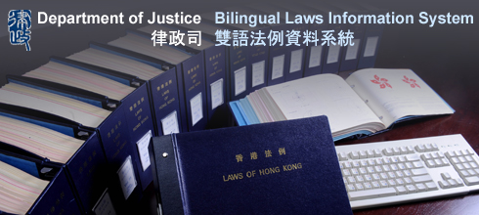
相關網址
Related Websites
中醫藥管理委員會
Chinese Medicine Council of Hong Kong
www.cmchk.org.hk
衞生署中醫藥事務部
Chinese Medicine Division Website
www.cmd.gov.hk
香港法規
Department of Justice
www.legislation.gov.hk
Notes:
各項中醫藥規管和法規的詳細資料可以在相關網址內找到

Slide 31
謝謝
Thank You

